Slide 1

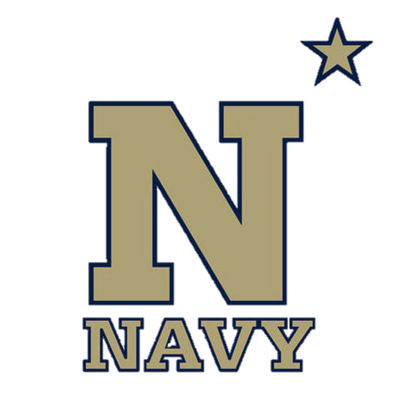
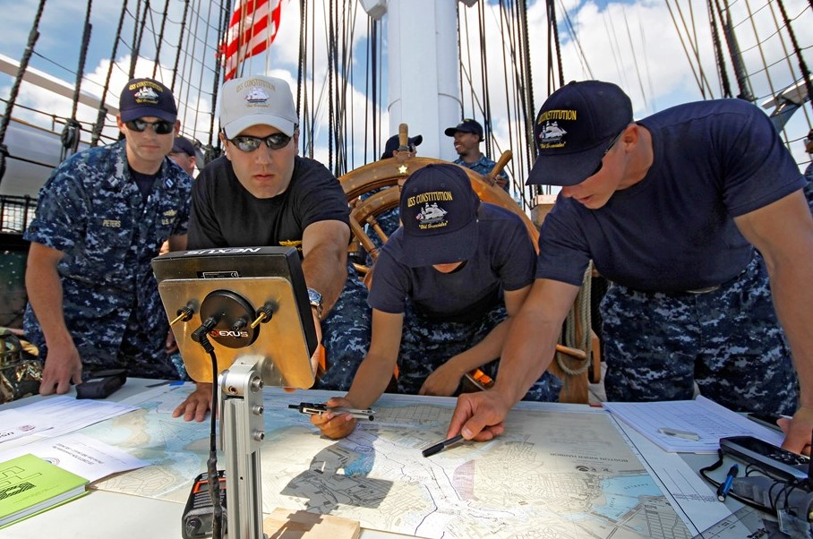
Dead Reckoning and Piloting
NN220-07
SEANAV I United States Naval Academy
NN220 – Fundamentals of Navigation– Updated May 2023
Operations Officer I HMS PROTECTOR A173 I The Ice Patrol Ship

Slide 2
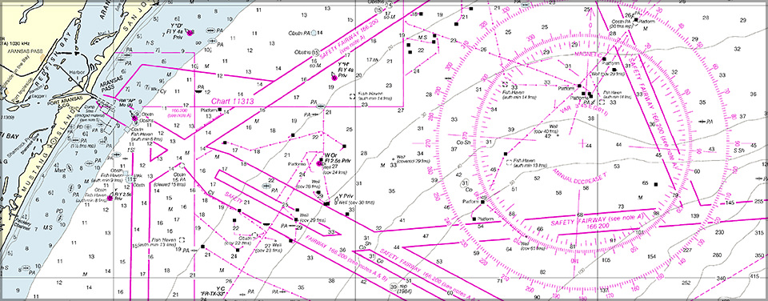
References
-The American Practical Navigator, Pub. No. 9, Bowditch, VOL. 1, 2019 Edition -Surface Ship Navigation Department Organizations and Regulations Manual (NAVDORM), COMNAVSURFPAC/COMNAVAIRPAC/COMNAVAIRLANT/COMNAVSURFLANT INSTRUCTION 3530.4 series
SEANAV I United States Naval Academy
NN220 – Fundamentals of Navigation
Operations Officer I HMS PROTECTOR A173 I The Ice Patrol Ship

Slide 3
Enabling Objectives
1 - DEFINE Piloting. 2 - DESCRIBE the steps needed to prepare the plotting station. 3 - IDENTIFY the applicable records book needed to record plotting information. 4 - UNDERSTAND how to determine Gyrocompass Error. 5 - IDENTIFY the critical watchstanders needed to transition to restricted waters transit IAW the NAVDORM. 6 - DESCRIBE Visual Fix and demonstrate how a plotter fixes and labels a position using visual NAVAIDs. 7 - DESCRIBE RADAR Fix and demonstrate how a plotter fixes and labels a position using RADAR NAVAIDs. 8 - DESCRIBE COMPOSITE Fix and demonstrate how a plotter fixes and labels a position using both Visual and RADAR NAVAIDs. 9 - DESCRIBE GPS Fix and demonstrate how a plotter fixes and labels a position using GPS. 10 - DESCRIBE Estimated Position and demonstrate how a plotter fixes and labels it. 11 - DESCRIBE Running Fix and its application in piloting. 12 - EXPLAIN the required fix intervals IAW Table 3-A. 13 - DEFINE Dead Reckoning (DR). 14 - IDENTIFY the Six Rules of Dead Reckoning. 15 - DEMONSTRATE how to properly plot and label the course line and DR positions. 16 - DEFINE Set and Drift and demonstrate how to calculate it. 17 - DEFINE Course Made Good (CMG) and Speed Made Good (SMG) and demonstrate how to determine it. 18 - DESCRIBE Compensating Course and demonstrate how to determine it. 19 - DESCRIBE Correcting Course and demonstrate how to determine it.
SEANAV I United States Naval Academy
NN220 – Fundamentals of Navigation
Operations Officer I HMS PROTECTOR A173 I The Ice Patrol Ship

Slide 4
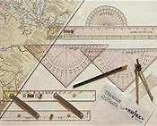
NAVKIT
-Ensure that you have the following instruments: Dividers Compasses Pencils and Erasers (A mechanical pencil is preferred due to the fine edge) Nautical Slide Rule (For quick and easy time, speed and distance calculations) Markers (Green, Yellow, Blue) Fine Edge Black Marker NAVAID Template Chart Correction Template All items should be available in your NAVKIT.
SEANAV I United States Naval Academy
NN220 – Fundamentals of Navigation
Operations Officer I HMS PROTECTOR A173 I The Ice Patrol Ship

Slide 5
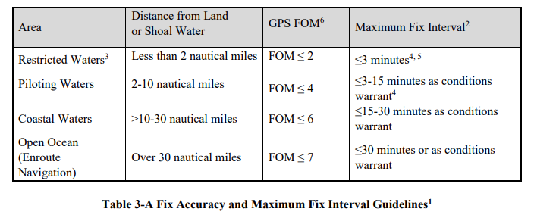
Piloting
Piloting-Involves navigating a vessel in restricted waters and fixing its position as precisely as possible at frequent intervals. -Intervals are in accordance with the NAVDORM, Table 3-A. -The navigator will assign watchstanders to roles to assist in piloting. -Proper preparation and attention to detail is critical during this phase!
SEANAV I United States Naval Academy
NN220 – Fundamentals of Navigation
Operations Officer I HMS PROTECTOR A173 I The Ice Patrol Ship

Slide 6
Prepare the Plotting Station
We must get prepared to navigate in restricted waters long before we get underway. Ensure you have completed the following:
Have your NAVKIT ready.
Assemble all your charts and publications.
Make sure you have prepared your charts IAW the chart preparation checklist.
Ensure you have all the record books needed (Bearing Book, Position Log, Deck Log, etc)
Verify tides, currents and weather.
Conduct a Navigation/Transit Brief
SEANAV I United States Naval Academy
NN220 – Fundamentals of Navigation
Operations Officer I HMS PROTECTOR A173 I The Ice Patrol Ship

Slide 7
Record Books
-Chapter 6 of the NAVDORM covers all the record books, logs and forms needed for a US Navy warship. -Ship’s Deck Log-Maintained as a complete daily record of all important events which may affect the crew, safety of the ship or has historical value. -Ship’s Position Log-Record of all positions and sounding from all sources used, including GPS and fathometer sounding. -Standard Bearing Book-Record of the data obtained to determine the ship’s position by visual bearings, sextant angles, RADAR bearings or RADAR ranges. -Navigation Workbook-Record of all observations and computations used for the navigation of the ship.
SEANAV I United States Naval Academy
NN220 – Fundamentals of Navigation
Operations Officer I HMS PROTECTOR A173 I The Ice Patrol Ship

Slide 8
Record Books
-Chapter 6 of the NAVDORM covers all the record books, logs and forms needed for a US Navy warship. -RADAR Navigation Log-Sometimes called a navigational fix log, is used whenever RADAR navigation is conducted. -Chart and Publications Corrections-record of all corrections required for the current allowance of NGA charts, DNCs, ENCs and publications established by the current edition of the Nautical Chart and Publications Allowance. -Notice to Mariners and Summary of Corrections-A series of publications that incorporates a historic record of corrections dating from the most recent edition date for NGA products back to July 1975.
SEANAV I United States Naval Academy
NN220 – Fundamentals of Navigation
Operations Officer I HMS PROTECTOR A173 I The Ice Patrol Ship

Slide 9
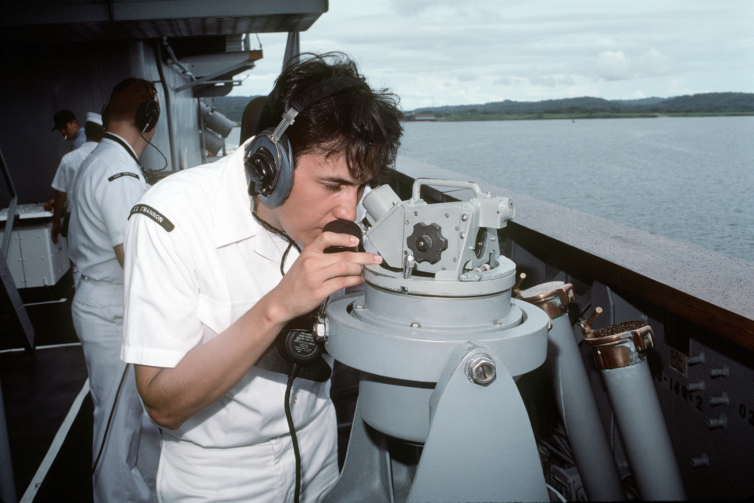
Gyrocompass Error
Gyrocompass-A non-magnetic compass based on a fast-spinning disc and the rotation of the Earth that finds true north. -Used by bearing takers to take bearings to NAVAIDs. -The total of all the combined errors of the gyrocompass is called Gyro Error. This error will affect the bearings taking during piloting. -Expressed in East or West, just like variation and deviation. -To find Gyro Error, compare the charted bearing to a known object from your position to the Gyrocompass bearing. -If “Gyro is Best” Error is West, If “Gyro is Least” Error is East.
SEANAV I United States Naval Academy
NN220 – Fundamentals of Navigation
Operations Officer I HMS PROTECTOR A173 I The Ice Patrol Ship

Slide 10
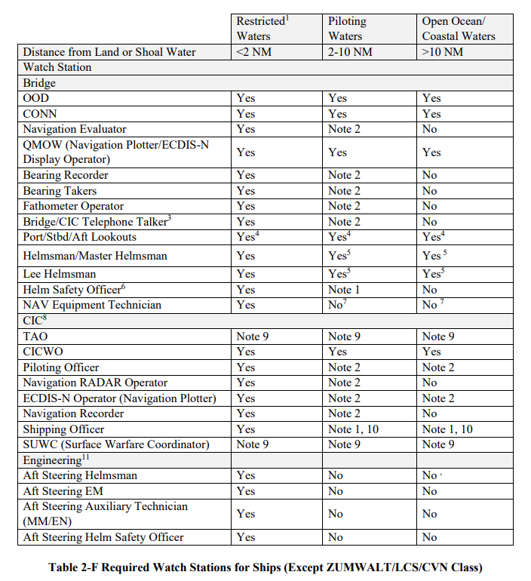
Watchstanders
-The NAVDORM dictates the required watchstations for the different phases of navigation.
-Requirements will be different for different platforms.
-The critical watchstations will include:
Navigation Evaluator
Navigation Plotter/ECDIS-N Operator
Bearing Takers
Navigation RADAR Operator
Bearing Recorder
SEANAV I United States Naval Academy
NN220 – Fundamentals of Navigation
Operations Officer I HMS PROTECTOR A173 I The Ice Patrol Ship

Slide 11
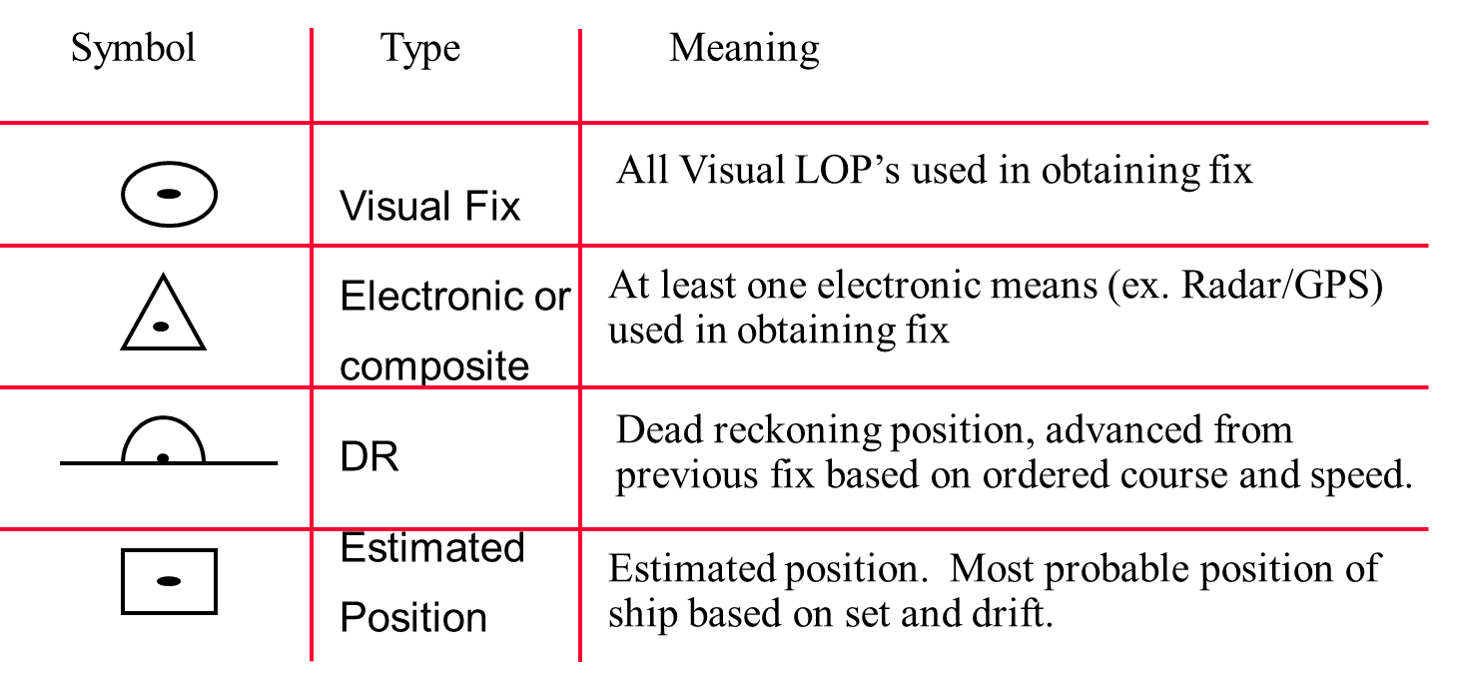
Fix Symbology
- All fixes plotted on the chart will be represented by a symbol and labeled with the four digit time corresponding to when it was taken (ex. 1600)
SEANAV I United States Naval Academy
NN220 – Fundamentals of Navigation
Operations Officer I HMS PROTECTOR A173 I The Ice Patrol Ship

Slide 12
Lines of
Position
- Probably the most important and elemental concept in navigation;
- Whereas an exact position is a point on a chart, an LOP is a line, along which the navigator knows he or she is located. It is measured from a NAVAID;
- A minimum of two LOPs is needed for a fix, and three or more LOPs yield a more reliable fix (3 LOPs required IAW NAVDORM);
- Can be obtained in many ways, but in piloting the 2 primary means are:
a) Visual – bearing of a known, fixed object through the use of the pelorus or gyro repeater; and
b) RADAR – range (distance) to a known object through the use of the ship’s radar.
SEANAV I United States Naval Academy
NN220 – Fundamentals of Navigation
Operations Officer I HMS PROTECTOR A173 I The Ice Patrol Ship

Slide 13
Lines of
Position
Visual bearings are nearly always preferable to radar bearings. You are less likely to make an error if you can see the object rather than trusting that the electronic image you are using is the same one you think it is;
You must exercise some judgment in choosing the objects you will use for your bearings. Most important:
=> the objects must appear on the chart; and
=> choose objects that will yield bearings that are widely spread.
- If you have multiple LOPs to take:
Visual - “Beam, Bow, Stern” → Should avoid shooting anything on the stern as there is no appreciable bearing change.
RADAR - “Bow, Stern, Beam” → Should avoid shooting anything on the beam as there is no appreciable range change.
SEANAV I United States Naval Academy
NN220 – Fundamentals of Navigation
Operations Officer I HMS PROTECTOR A173 I The Ice Patrol Ship

Slide 14
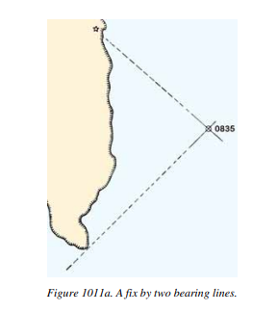
Visual Lines of
Position
- Visual LOPs are represented by a straight line towards a fixed object (visual NAVAID); and
- It is read from the center of the object; and
- It is labeled with the time (mandatory) and the direction (option).
* Notice that the line you are drawing is actually the reciprocal of the bearing you took on the object, since you are drawing it from the observed object rather than to it.
SEANAV I United States Naval Academy
NN220 – Fundamentals of Navigation
Operations Officer I HMS PROTECTOR A173 I The Ice Patrol Ship

Slide 15
Optimum Spread of Visual LOPs
- Prevents the bearings from being too close together and helps provide a more precise fix;
- The optimum spread for LOP’s is 120°; and
- If all NAVAIDs are on the same side of the ship, they should be 60° apart.
SEANAV I United States Naval Academy
NN220 – Fundamentals of Navigation
Operations Officer I HMS PROTECTOR A173 I The Ice Patrol Ship

Slide 16
TWR
3 aids = 120°
120
1412
Fl R 4 sec
Tank

Slide 17
Same side = 60°
0930
60
60
TWR
TANK
LT

Slide 18
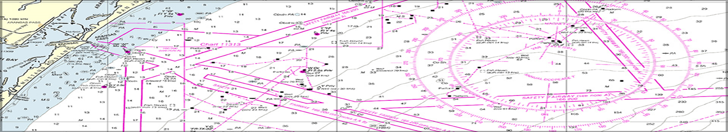
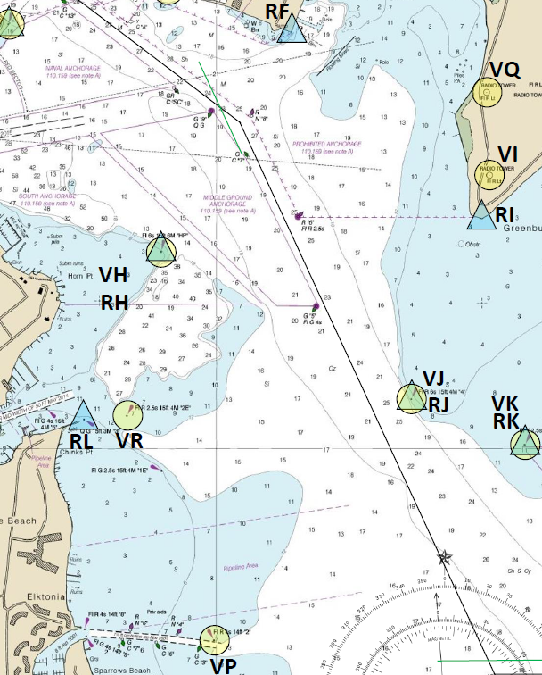
Visual Fix
Intersection of the 3 LOPs is the position of your ship (fix)!
A Visual fix is a position of your vessel on the chart; and
It is obtained based on a combination of 3 visual lines of position.
VH bears 316°
VR bears 255°
VP bears 207°

Slide 19
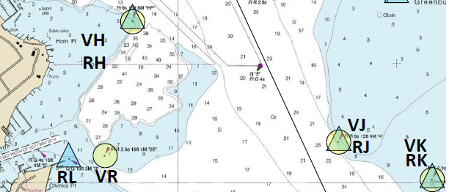
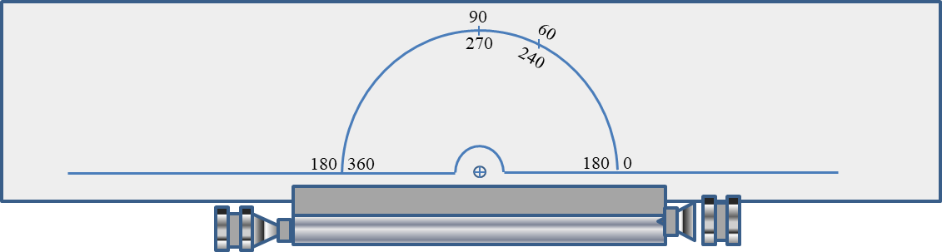
How to draw LOPs without Compass Rose
VR Bears 240°T

Slide 20
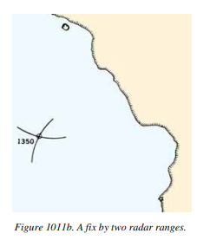
RADAR Lines of
Position
- RADAR LOPs are represented by a range arc line towards a conspicuous RADAR object (RADAR NAVAID); and
- It is read from the leading edge of the object; and
- It is labeled with the time (mandatory) and the range (option).
* Notice that your dividers will create a curved line when you draw the LOP from the RADAR NAVAID.
SEANAV I United States Naval Academy
NN220 – Fundamentals of Navigation
Operations Officer I HMS PROTECTOR A173 I The Ice Patrol Ship

Slide 21
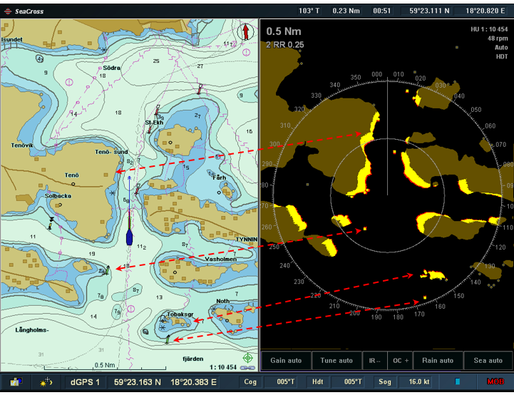
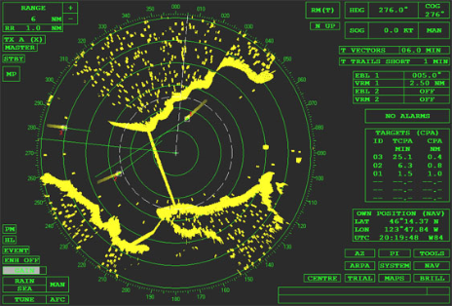
RADAR Lines of
Position
Radar image shows distinct objects on water and the coast contour.
Radar will not show objects on land!
SEANAV I United States Naval Academy
NN220 – Fundamentals of Navigation
Operations Officer I HMS PROTECTOR A173 I The Ice Patrol Ship

Slide 22
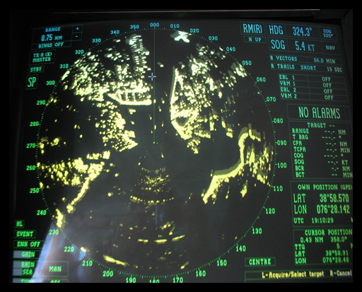
Triton Light is at a range of 500 yards… This is a RADAR LOP!

Slide 23

RADAR Fix
Intersection of the 3 LOPs is the position of your ship (fix)!
A RADAR fix is a position of your vessel on the chart; and
It is obtained based on a combination of 3 RADAR lines of position.
RH is 500 yards
RI is 550 yards.
RL is 600 yards

Slide 24
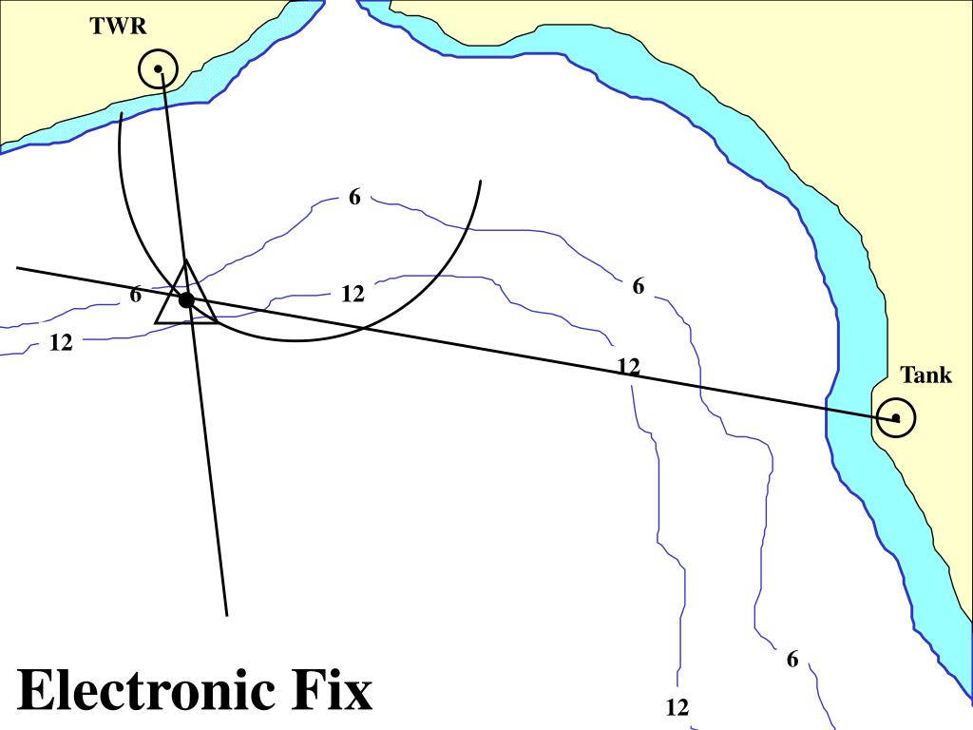
Composite Fix
- Composite Fixes are fixes by both RADAR and Visual Lines of Position.
- It will be marked as an Electronic Fix.
- It is labeled with the time (mandatory).
SEANAV I United States Naval Academy
NN220 – Fundamentals of Navigation
Operations Officer I HMS PROTECTOR A173 I The Ice Patrol Ship

Slide 25
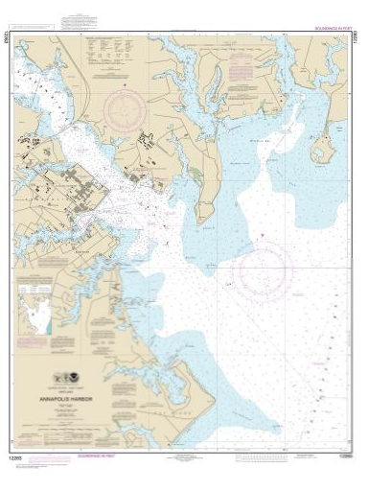
GPS Fix
- GPS fixes are positioned from a GPS receiver.
- It can also be attained from other GNSS systems.
- The US Navy requires GPS systems that are encrypted.
Read as Latitude/Longitude
Example:
Riverside Observatory coordinates:
- Lat. = 33°57’ 12’’ N
- Long. = 117°23’ 46’’ W
Remember:
1°= 60’ (minutes)
1’ = 60’’ (seconds)
LATITUDE
LONGITUDE
SEANAV I United States Naval Academy
NN220 – Fundamentals of Navigation
Operations Officer I HMS PROTECTOR A173 I The Ice Patrol Ship

Slide 26
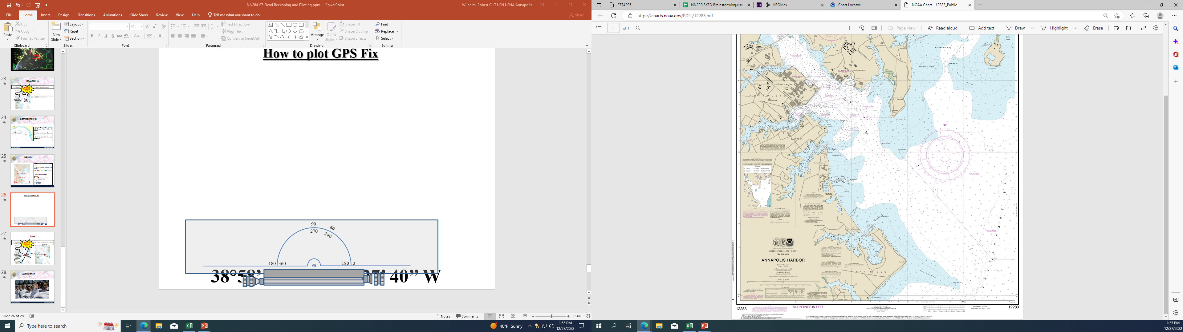
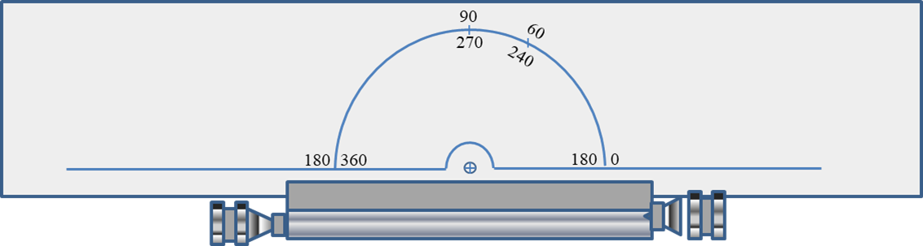
How to plot GPS Fix
38°58’ 20’’ N / 076°27’ 40’’ W

Slide 27
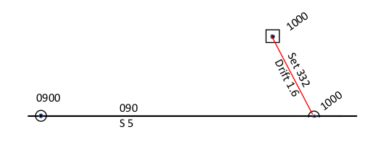
Estimated Position
- An Estimated Position (EP) is the most probable position of a craft determined from incomplete data or data of questionable accuracy.
- Can be determined by applying a correction to a DR position, accounting for set and drift or by plotting lines of position of questionable accuracy.
- It is commonly gained from plotting two lines of position.
SEANAV I United States Naval Academy
NN220 – Fundamentals of Navigation
Operations Officer I HMS PROTECTOR A173 I The Ice Patrol Ship

Slide 28
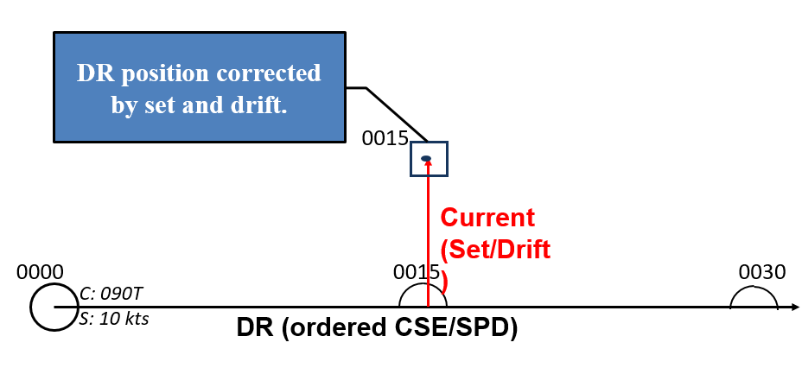
Estimated Position
Based on Set and Drift
SEANAV I United States Naval Academy
NN220 – Fundamentals of Navigation
Operations Officer I HMS PROTECTOR A173 I The Ice Patrol Ship

Slide 29

Estimated Position
If you continue on the same ordered course and speed where do you estimate to be at 0836?
0830
0833
0836
C - 090°
S - 6 kts
Set & Drift
0836
CMG & SMG
C - 090°
S - 6 kts
0839
0833
CMG & SMG
0836
Use your CMG and SMG to plot an EP!

Slide 30
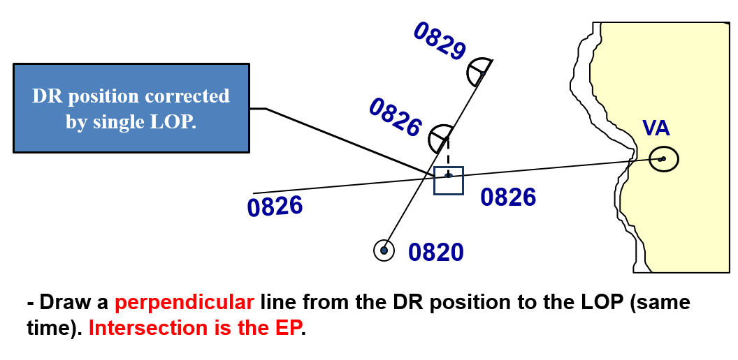
Estimated Position Based on Single LOP
SEANAV I United States Naval Academy
NN220 – Fundamentals of Navigation
Operations Officer I HMS PROTECTOR A173 I The Ice Patrol Ship

Slide 31
Running Fixes
- A method for determining the ship’s position with visual LOP’s when only one object is visible.
-Use the following method:
Plot a bearing to a NAVAID (LOP 1).
Plot a second bearing to the same NAVAID at a later time (LOP 2).
Plot a third bearing to the same NAVAID at a later time (LOP 3).
Advance LOP 1 and LOP 2 to the time that LOP 3 was taken.
The intersection of the three LOPs is a running fix!
SEANAV I United States Naval Academy
NN220 – Fundamentals of Navigation
Operations Officer I HMS PROTECTOR A173 I The Ice Patrol Ship

Slide 32
Running Fixes
Attempt to get
0809 Running Fix
0809
0806
Dead Reckoning!
0803
0809 RFIX
0809
0815
C 080
0812
0806
0803
S 10
Advance Parallel, For predicted distance
in 10kt, 6min(0803-0809)
0800
Got a fix!
Advance Parallel, For predicted distance
in 10kt, 3min(0806-0809)
TANK
Now, I can see only a TANK!
Time to take 3 LOPs
Notes:
Running Fix: Done when only 1 navigation aid is available. Completed by taking 3 fixes over successive fix intervals based on your DRs.

Slide 33
Dead Reckoning
The process of estimating your ship’s future position without considering the effects of wind and current. Based on the ship’s ordered course and speed.
Can help you:
Determine if the current ordered course and speed are safe
Determine when to make course changes or to compute time left on the present course
Determine when to adjust speed
Predict the time of sighting lights and other aids to navigation
Identify landmarks
Determine which navigation aids will provide the best fix
Determine the effects of wind and current on the vessel
Estimate the ship’s position for celestial navigation computations
Determine the validity of a fix
SEANAV I United States Naval Academy
NN220 – Fundamentals of Navigation
Operations Officer I HMS PROTECTOR A173 I The Ice Patrol Ship

Slide 34
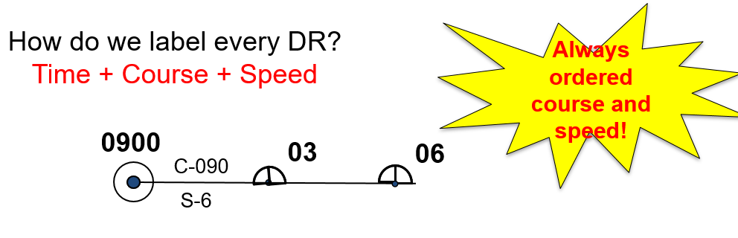
Dead Reckoning
SEANAV I United States Naval Academy
NN220 – Fundamentals of Navigation
Operations Officer I HMS PROTECTOR A173 I The Ice Patrol Ship

Slide 35
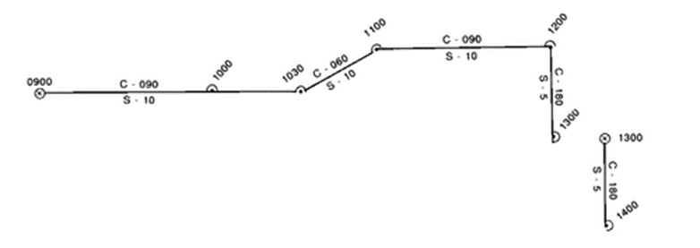
Six Rules of Dead Reckoning
Plot a DR position…
1. At least every hour on the hour while in open ocean
2. At every course change
3. At every speed change
4. After every fix or running fix
5. When obtaining a single line of position (LOP)
6. Label each fix with course, speed, time, and draw a new course line from each fix or running fix. The DR plot should cover at least the next two fix intervals.
SEANAV I United States Naval Academy
NN220 – Fundamentals of Navigation
Operations Officer I HMS PROTECTOR A173 I The Ice Patrol Ship

Slide 36
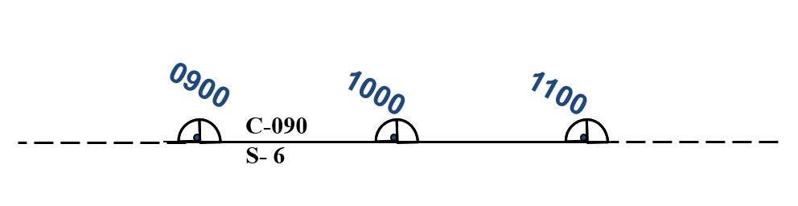
1) Every Hour on the Hour
This rule ensures there is a minimum DR interval for every navigator to DR at least every hour.
SEANAV I United States Naval Academy
NN220 – Fundamentals of Navigation
Operations Officer I HMS PROTECTOR A173 I The Ice Patrol Ship

Slide 37
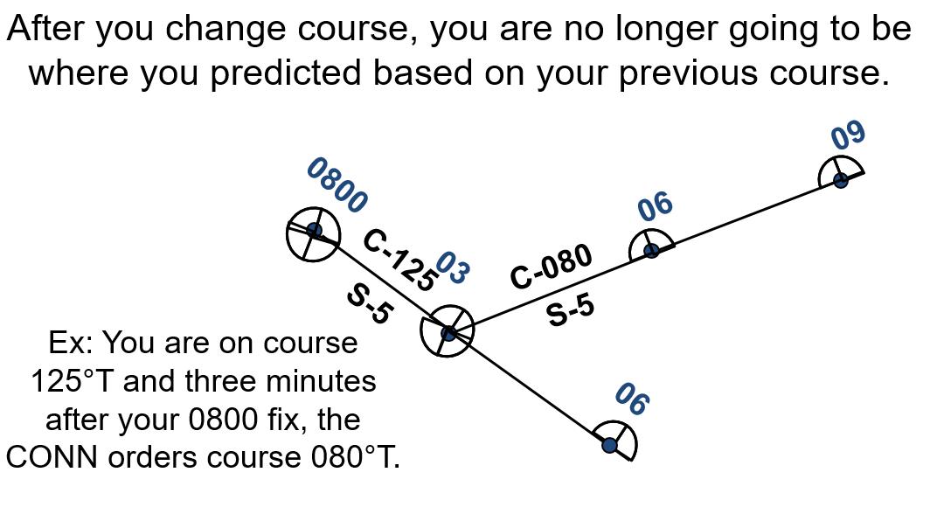
2) Every Course Change
SEANAV I United States Naval Academy
NN220 – Fundamentals of Navigation
Operations Officer I HMS PROTECTOR A173 I The Ice Patrol Ship

Slide 38
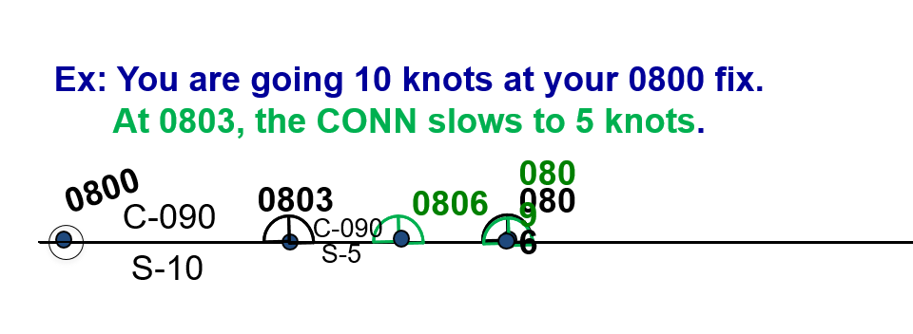
3) Every Speed Change
After you change speed, you are no longer going to be where you predicted based on your previous speed.
SEANAV I United States Naval Academy
NN220 – Fundamentals of Navigation
Operations Officer I HMS PROTECTOR A173 I The Ice Patrol Ship

Slide 39
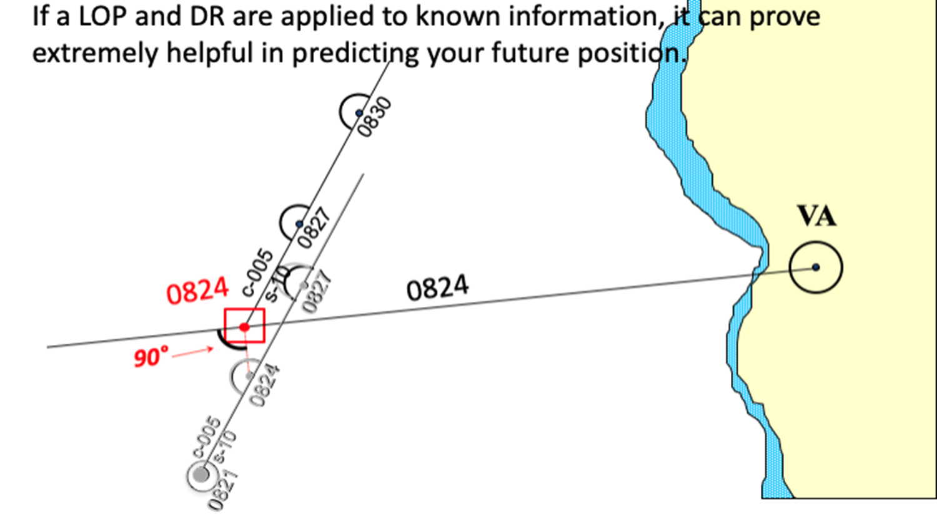
4) After a Single LOP
SEANAV I United States Naval Academy
NN220 – Fundamentals of Navigation
Operations Officer I HMS PROTECTOR A173 I The Ice Patrol Ship

Slide 40
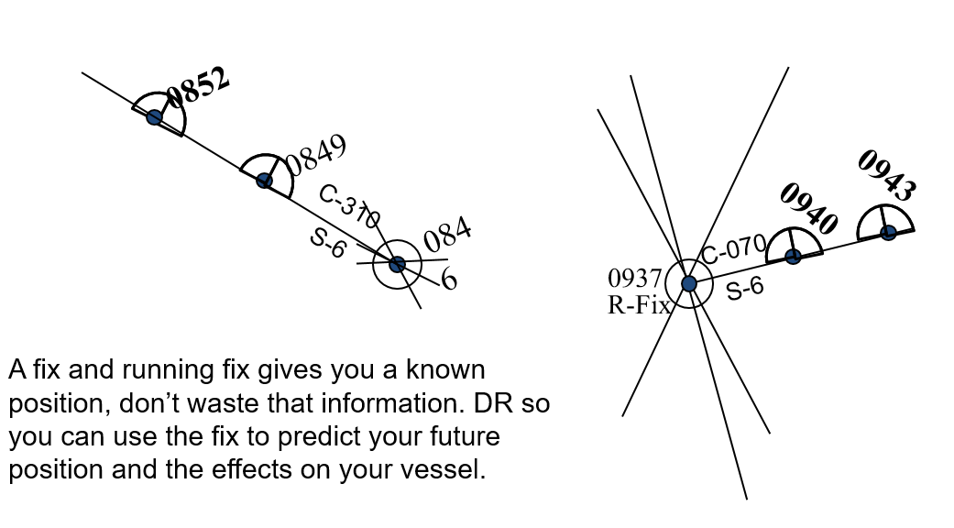
5) After Every Fix or Running Fix
SEANAV I United States Naval Academy
NN220 – Fundamentals of Navigation
Operations Officer I HMS PROTECTOR A173 I The Ice Patrol Ship

Slide 41
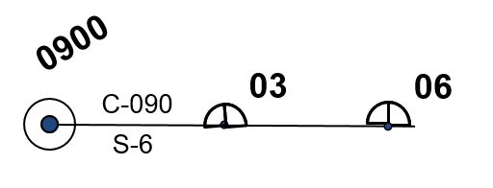
6) Draw a New Course Line From Your Fix and DR Out
Two Fix Intervals
SEANAV I United States Naval Academy
NN220 – Fundamentals of Navigation
Operations Officer I HMS PROTECTOR A173 I The Ice Patrol Ship

Slide 42
Time/Speed/Distance
D = S x T
where: D = distance traveled in nautical miles (nm)
S = speed in knots
T = time in hours
SEANAV I United States Naval Academy
NN220 – Fundamentals of Navigation
Operations Officer I HMS PROTECTOR A173 I The Ice Patrol Ship

Slide 43
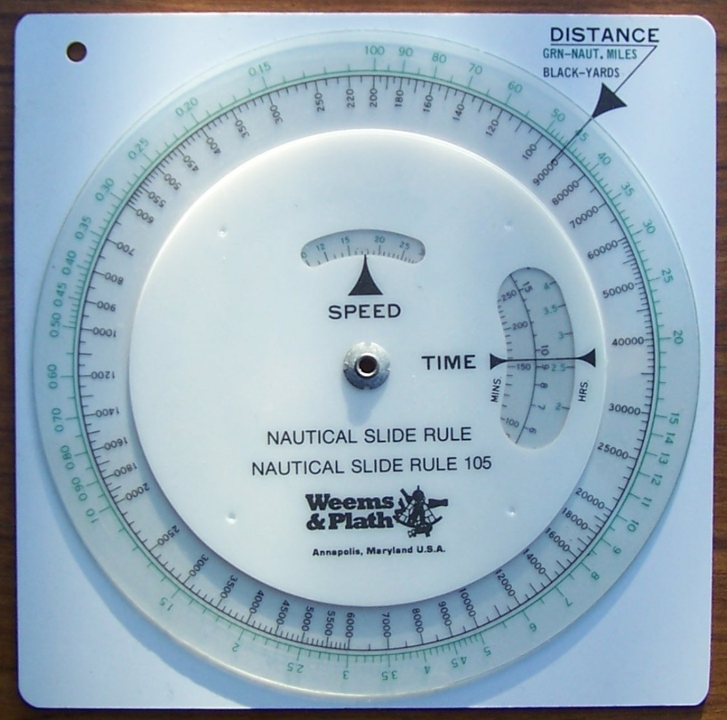
Speed Wheel
SEANAV I United States Naval Academy
NN220 – Fundamentals of Navigation
Operations Officer I HMS PROTECTOR A173 I The Ice Patrol Ship

Slide 44
Three Minute Rule
The distance of travel of a ship in yards in
three minutes is equal to its speed in knots multiplied by 100.
D = S x 100
where: D = distance traveled (yards)
S = speed (knots)
SEANAV I United States Naval Academy
NN220 – Fundamentals of Navigation
Operations Officer I HMS PROTECTOR A173 I The Ice Patrol Ship

Slide 45
Six Minute Rule
The distance of travel of a ship in nautical miles in six minutes is equal to its speed in knots divided by 10.
D = S / 10
where: D = distance traveled (nm)
S = speed (knots)
SEANAV I United States Naval Academy
NN220 – Fundamentals of Navigation
Operations Officer I HMS PROTECTOR A173 I The Ice Patrol Ship

Slide 46
Practice on Chartlet Plot the First Fix
Date | RC | VH | RF |  | Depth
Time
0900 | 300yds | 154 | 1200yds |  | 18ft
Notes:
Teaching Points:
Read along the Meridian
Visual Fixes are circles
Optimal spread of LOP
When should we take another fix based on the water we are in? (NAVDORM)
After every fix we need to DR…Leads you into Dead Reckoning
Purpose
6 Rules
How to plot….leads into 3 min rule

Slide 47
Practice on Chartlet Plot DR for First Fix
Ordered Course: 126T
Ordered Speed: 6kts
What information does this DR provide?

Slide 48
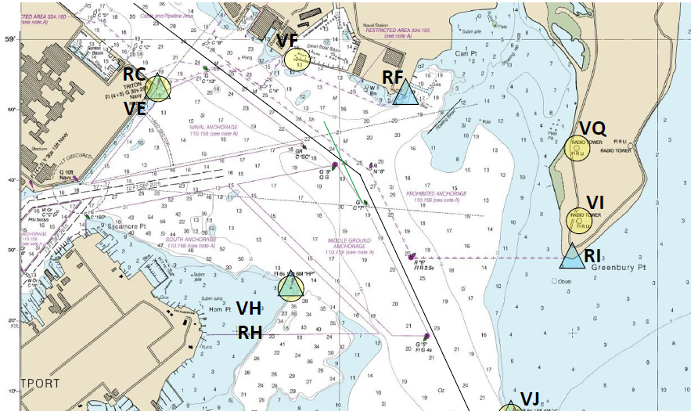
Practice on Chartlet Plot DR for the First Fix
0900
C 126
S 6
03
06

Slide 49
Practice on Chartlet Plot the Second Fix and DR
Date | RC | VH | RF |  | Depth
Time
0900 | 300yds | 154 | 1200yds |  | 18
 | VE | VR | VI
0903 | 281 | 190 | 111 |  | 12
Ordered Course: 126T
Ordered Speed: 6kts
What information does this DR provide?
Notes:
Teaching Points:
Read along the Meridian
Visual Fixes are circles
Optimal spread of LOP
When should we take another fix based on the water we are in? (NAVDORM)
After every fix we need to DR…Leads you into Dead Reckoning
Purpose
6 Rules
How to plot….leads into 3 min rule

Slide 50
Practice on Chartlet Plot the Second Fix and DR
0900
C 126
S 6
0903
0903
C 126
S 6
0906
0906
0909

Slide 51
Current Triangle
Current 🡺 resultant of all offsetting influences!!!
Set: The direction toward which current is flowing.
Drift: The speed of the current.
0015
CMG/SMG
Current (Set/Drift)
0000
15
30
C: 090T
S: 10 kts
DR (ordered CSE/SPD)
Offsetting influences: tidal current, winds, effect of the winds on the ship itself, heavy seas, inaccurate steering, error in engine calibration...

Slide 52
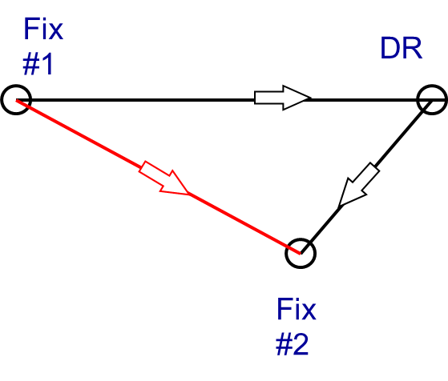
Calculate Set and Drift
To calculate Set
Draw a line from the DR to the second fix
Place slide ruler on the line and transpose over to the compass rose
Read the direction off the compass rose in the direction of the line
To calculate Drift
Measure the distance between the DR and the second fix
Divide that distance by time as an application of: S = D / T
DR and fix have to be at same time!!!
CMG
Set

Slide 53
Practice on Chartlet Calculate Set and Drift for 0903 fix
0900
C 126
S 6
Set / Drift
Set: 107T
Drift: 2.5 knots
0903
0903
C 126
S 6
0906
0906
0909

Slide 54
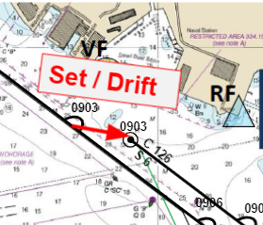
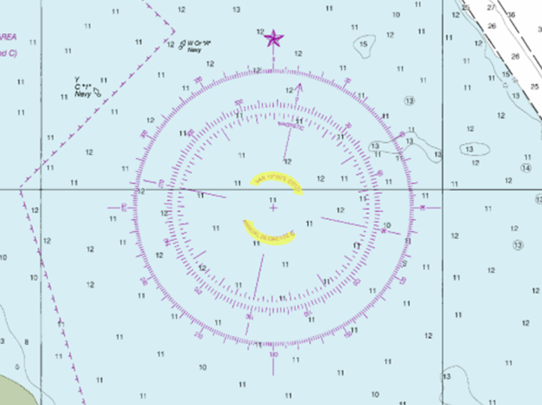
Practice on Chartlet Calculate Set and Drift for 0903 fix
90
100
110
280
270
290
180
360
180
0

Slide 55
Current Triangle
Ordered Course: The course which is ordered and is steered by the helmsman.
Ordered Speed: The speed which is ordered and is controlled by the lee-helmsman.
Course Made Good (CMG): resultant direction from a given point to a subsequent position, disregarding any intermediate course change;
Speed Made Good (SMG): speed based on distance of passage from a given point to a subsequent position;
Track Made Good (SMG): Combination CMG + SMG

Slide 56
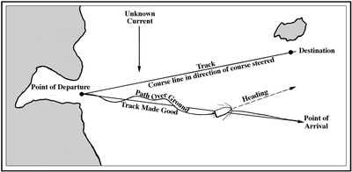
Current Triangle
CMG and SMG is always measured between 2 known positions!!!

Slide 57
Calculate CMG and SMG
To calculate CMG
Draw a line from the first fix to the second fix
Place slide ruler on the line and transpose over to the compass rose
Read the direction off the compass rose in the direction of the line
To calculate SMG
Measure the distance between the first fix and the second fix
Divide that distance by time as an application of S = D / T
CMG and SMG always between 2 known positions!!!
Fix #1
DR
CMG
Fix #2

Slide 58
Practice on Chartlet Calculate CMG/SMG for 0903 fix
0900
C 126
S 6
CMG / SMG
CMG – 120T
SMG - 8.1 knots
0903
0903
C 126
S 6
0906
0906
0909

Slide 59
Practice on Chartlet Plot 3rd Fix and DR
Date | RC | VH | RF |  | Depth
Time
0900 | 300yds | 154 | 1200yds |  | 18
 | VE | VR | VI
0903 | 281 | 190 | 111 |  | 12
 |  | VQ | RF
0906 | 294 | 082 | 440 yds |  | 20
Ordered Course: 155T
Ordered Speed: 4kts

Slide 60
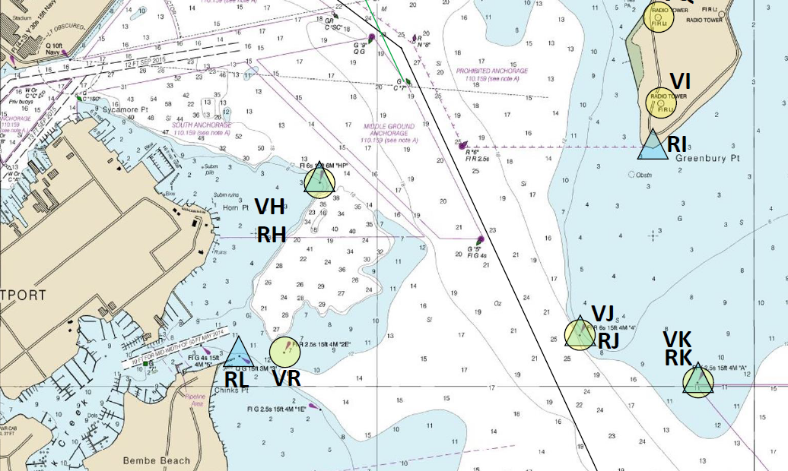
Practice on Chartlet Plot 3rd Fix and DR
0906
C-155
S- 4
Ordered Course: 155T
Ordered Speed: 4kts
0909
0912

Slide 61
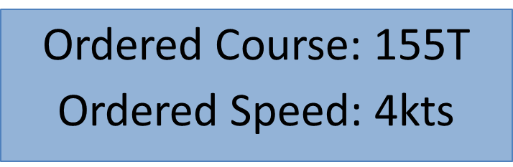
Practice on Chartlet Plot 4th Fix
Date | RC | VH | RF |  | Depth
Time
0900 | 300yds | 154 | 1200yds |  | 18
 | VE | VR | VI
0903 | 281 | 190 | 111 |  | 12
 |  | VQ | RF
0906 | 294 | 082 | 440 yds |  | 20
 |  |  | VH
0909 | 300 | 053 | 257 |  | 12

Slide 62
Practice on Chartlet Plot 4th Fix
0906
C-155
S-4
0909
0909
C-155
S-4
0912
0912
Ordered Course: 155T
Ordered Speed: 4kts
0915

Slide 63
Practice on Chartlet Calculate Set and Drift
C-155
S -4
Set: 087 T
Drift: 2kts
0909
0909
C-155
S-4
0912
0912
0915

Slide 64
Practice on Chartlet Calculate CMG and SMG
C - 155
S - 4
CMG: 136T
SMG: 5 kts
0909
0909
C-155
S-4
0912
0912
0915

Slide 65
Practice on Chartlet Estimate your Position at 0912
C - 155
S - 4
0909
0909
C-155
S-4
0912
0912
0912
0915

Slide 66
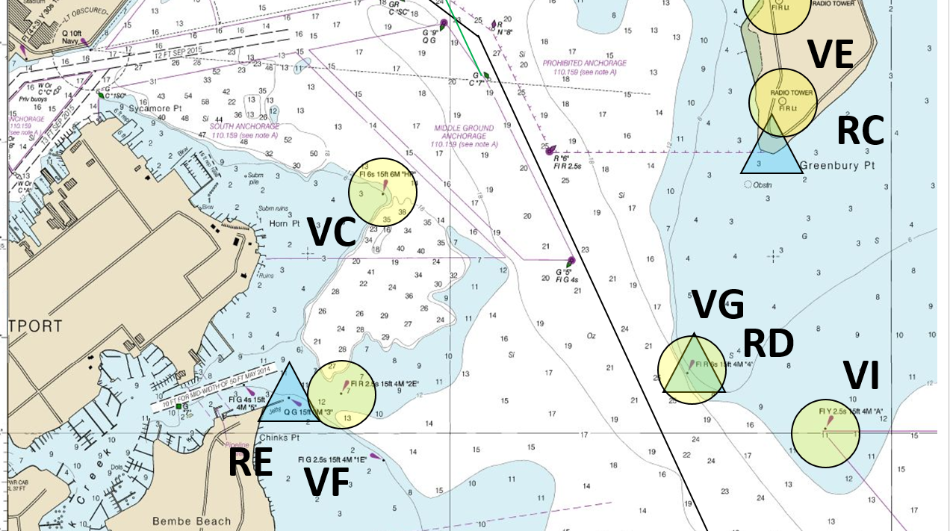
What should you do?
0906
C - 155
S - 4
0909
0909
C - 155
S- 4
0912
0912
0912
Current is deviating your ship from original track. What should you do?
1 – Regain track → Correcting Course
0915
2 – Make good the intended track → Compensating Course

Slide 67
Set & Drift
Direction From DR(D1) to FIX:
Set
(190°)
Distance From DR(D1) to FIX:
Drift
(300yds / 3min)
(3kts)
Ordered Course & Speed
0900
0903
0906
C-090
S- 10
D1
D2
090ºT / 081ºM
190° 300yds
Set & Drift
10 kts
12,000 yds
0903
0906
0909
C-090
Actual Track
S- 10
Course Made Good Speed Made Good

Slide 68
Calculate Compensating Course and Speed
Direction From FIX to DR(D2):
(073°)
×
If you don’t alter your course, the position after 3 minutes will be…
Distance From FIX to DR(D2):
(1,100yds / 3min)
(11kts)
0909
Set / Drift
Compensating Co/Sp
0900
0903
0906
C-090
073° 1,100yds
S- 10
D1
D2
090ºT / 081ºM
190° 300yds
10 kts
×
12,000 yds
0903
0906
0909
C-090
S- 10
0909
Compensating is… Co/Sp in order to compensate for the actual current (Set & Drift).
Co / Sp Made Good :
090° 10kts

Slide 69
Calculate Correcting Course and Speed
Direction From D3 to DR(D2):
If you don’t alter your course, the position after 3 minutes will be…
(060°)
Distance From D3 to DR(D2):
(1,280yds / 3min)
(12.8kts)
Set & Drift
Correcting Co/Sp
0900
C-090
0903
0906
060° 1,280yds
S- 10
D1
D2
090ºT / 081ºM
190° 300yds
10 kts
12,000 yds
C-090
0906
0909
0903
S- 10
Correcting is… effectively bringing you back to the second DR of your first fix (D2).
190° 300yds
0906
D3

Slide 70
Current Triangle
From DR(D1) to FIX :
Set & Drift
(190° 3kts)
From D3 to DR(D2) :
Correcting
(060°12.8kts)
From FIX to DR(D2) :
Compensating
(073°11kts)
0900
0903
0906
C-090
S- 10
D1
D2
Compensating
Set & Drift
0903
0906
0909
C-090
S- 10
Correcting
D3

Slide 71
Compensating Course
What is the compensating course and speed for the 0909 fix?
175ºT / 4.1 knots
C 155
S 4
0909
Compensating Course / Speed
0909
C 155
S 4
0912
0912
0912

Slide 72
Correcting Course
What is the correcting course and speed to regain track at 0912?
Expected set / drift
194ºT / 4.2 knots
C 155
S 4
Set and Drift
0909
Correcting Course / Speed
Set: 074T
Drift: 1.4kts
0909
C 155
S 4
0912
0912
0912

Slide 73
Correcting Course
Once ordered the correcting course and speed, your ship will regain track at 0912!
C 155
S 4
194ºT / 4.2 knots
Remember, the current is still acting on your ship!!!
0909
Correcting Course / Speed
0909
C 155
S 4
0912
0912
0912

Slide 74
Practice
D2
1200
1203
1206
000°T/003°M
10 kts
Set & Drift
(264° 5 kts)
1203
1206
1460yds
1160yds
1209
Correcting
(041°14.6 kts)
500yds
Compensating
(025°11.6 kts)
D3
D1
500yds
Ordered Course & Speed
000°10 kts
Course Made Good Speed Made Good
334°10.6 kts

Slide 75
Enabling Objectives
1 - DEFINE Piloting. 2 - DESCRIBE the steps needed to prepare the plotting station. 3 - IDENTIFY the applicable records book needed to record plotting information. 4 - UNDERSTAND how to determine Gyrocompass Error. 5 - IDENTIFY the critical watchstanders needed to transition to restricted waters transit IAW the NAVDORM. 6 - DESCRIBE Visual Fix and demonstrate how a plotter fixes and labels a position using visual NAVAIDs. 7 - DESCRIBE RADAR Fix and demonstrate how a plotter fixes and labels a position using RADAR NAVAIDs. 8 - DESCRIBE COMPOSITE Fix and demonstrate how a plotter fixes and labels a position using both Visual and RADAR NAVAIDs. 9 - DESCRIBE GPS Fix and demonstrate how a plotter fixes and labels a position using GPS. 10 - DESCRIBE Estimated Position and demonstrate how a plotter fixes and labels it. 11 - DESCRIBE Running Fix and its application in piloting. 12 - EXPLAIN the required fix intervals IAW Table 3-A. 13 - DEFINE Dead Reckoning (DR). 14 - IDENTIFY the Six Rules of Dead Reckoning. 15 - DEMONSTRATE how to properly plot and label the course line and DR positions. 16 - DEFINE Set and Drift and demonstrate how to calculate it. 17 - DEFINE Course Made Good (CMG) and Speed Made Good (SMG) and demonstrate how to determine it. 18 - DESCRIBE Compensating Course and demonstrate how to determine it. 19 - DESCRIBE Correcting Course and demonstrate how to determine it.
SEANAV I United States Naval Academy
NN220 – Fundamentals of Navigation
Operations Officer I HMS PROTECTOR A173 I The Ice Patrol Ship

Slide 76
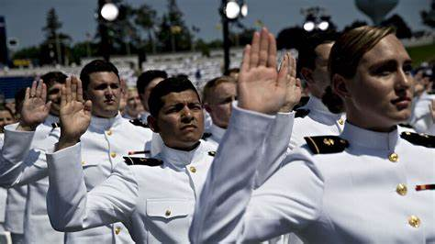
Questions?
SEANAV I United States Naval Academy
NN220 – Fundamentals of Navigation
Operations Officer I HMS PROTECTOR A173 I The Ice Patrol Ship

